Slide 1

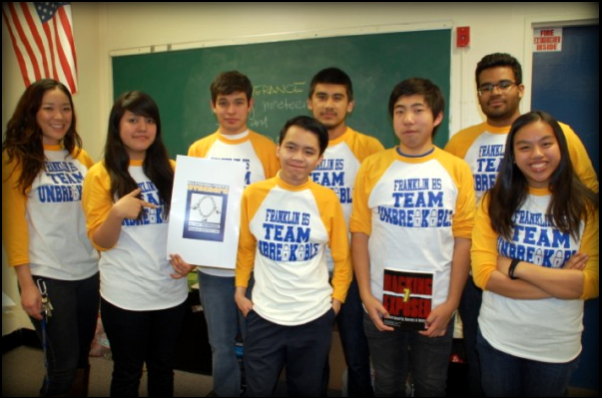

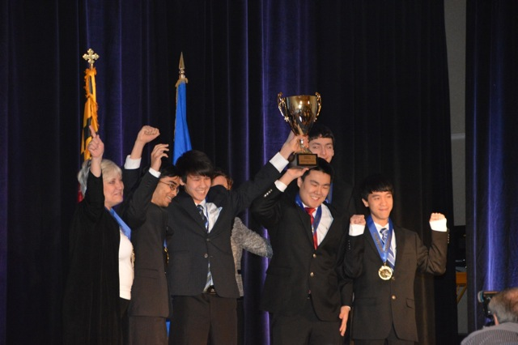
CyberPatriot VI Volunteering for STEM: US 2020
November 4, 2013
Ray Aragon, SE SLED
Steve Gyurindak, SE FED

Slide 2
CyberPatriot VI (6th season)
The CyberPatriot program is the largest national Cyber
Security competition. High School students learn about
Information security and the importance of secure hosts, applications, network services, and infrastructure.
The CyberPatriot program is sponsored by:
Air Force Association (AFA)

Slide 3
CyberPatriot basic info
1500+ schools compete in two Divisions
Service Division (JROTC)
Open Division
Local, Regional, and National Cyber competitions through the year
Schools normally have a coach and Cisco volunteers will help with Cisco component of the competition
Last year Steve Gyurindak successfully lobbied for the CP program to include a Cisco Networking component in the finals.
Cisco Content is sub-CCNA (network basics)
Kids are very interested in learning about how you got into “IT” or “High Tech.”
Notes:
Last year Steve Gyurindak successfully lobbied for the CP program to include a Cisco Networking component in the finals
Kids are very interested in learning about how you got into “IT” or “High Tech.”

Slide 4
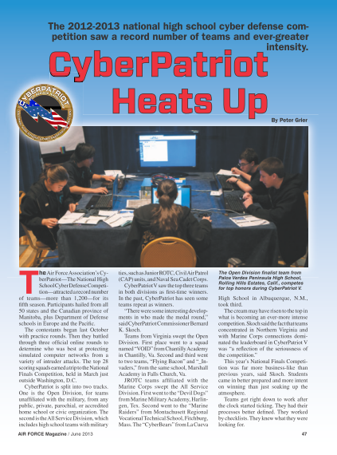
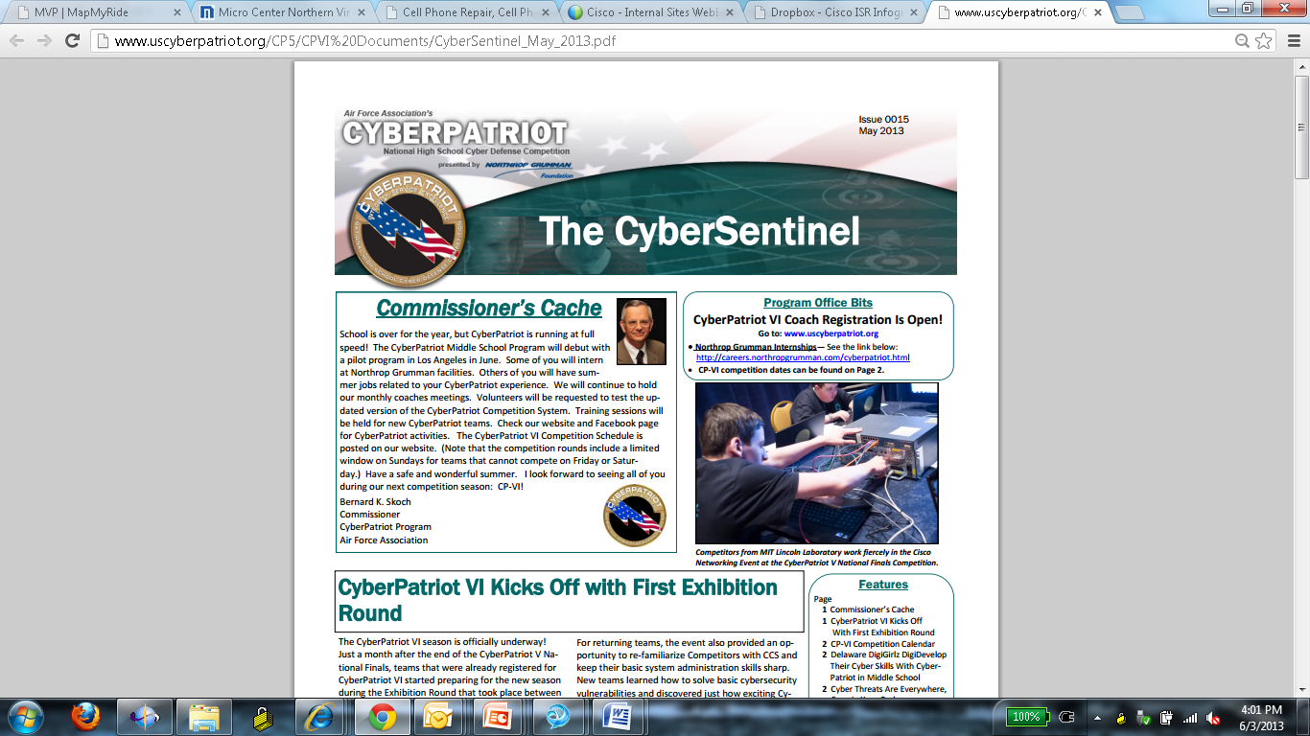
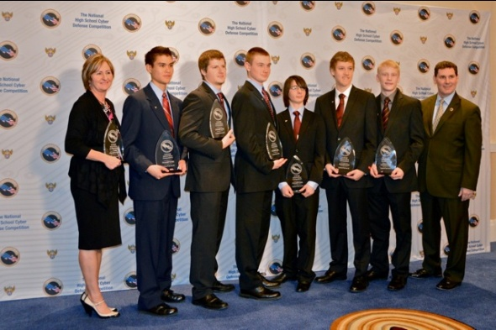
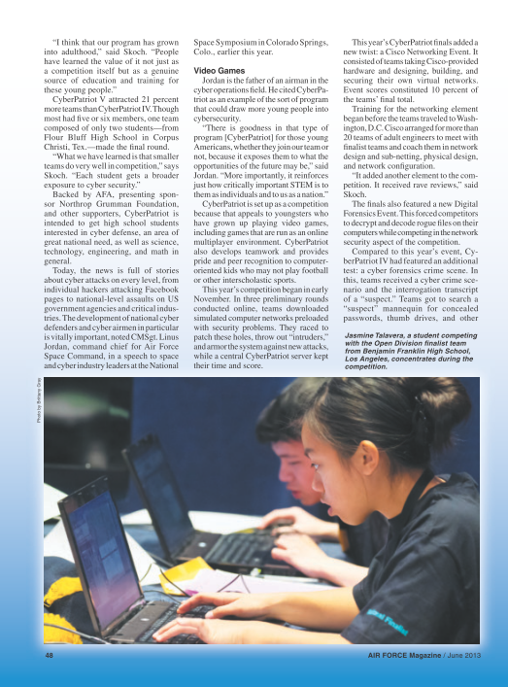
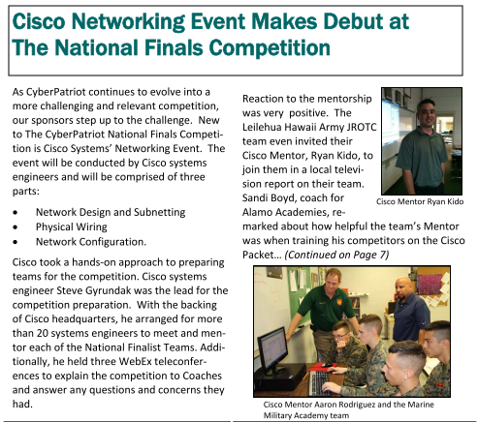
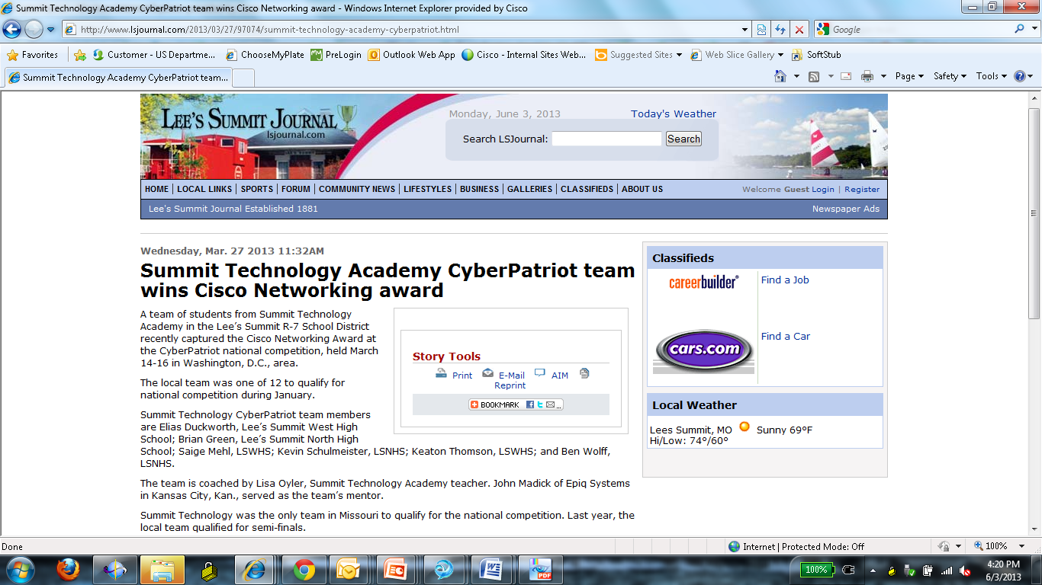
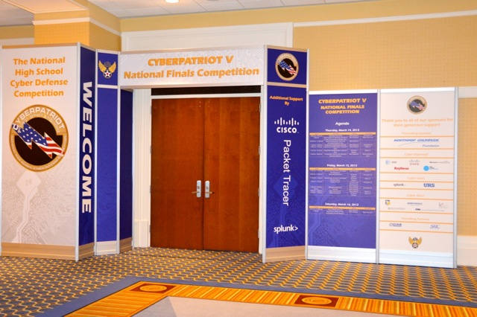
CyberPatriot and Cisco
Notes:
CyberPatriot is THE national high school cyber defense competition. It has been carefully structured to excite, educate, and motivate participants.
CyberPatriot is:
Designed to instill in all participants the importance to our nation of cyber, cyber security, and good computer security practices.
Designed to motivate all participants to consider STEM academic disciplines to meet our nation’s needs.
Designed to motivate many participants to become the next generation of cyber defenders and our nation’s “digital workforce.”
Cisco Public Sector has been supporting CyberPatriot for 3 years. This past year a Cisco Networking fundamentals exercise was included in the National Finals Competition.
Next year Cisco curriculum will be taught throughtout the school year
These snapshots highlight some of the press releases from across the country highlighting the partnership between CyberPatriot and Cisco

Slide 5
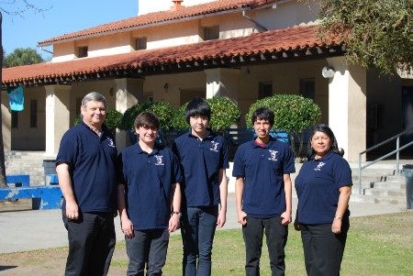
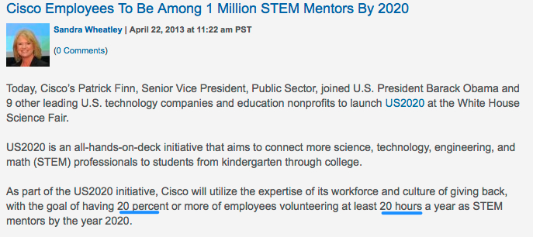
STEM: Science Technology Engineering and Math
Notes:
In the U.S. we have a shortage of students pursuing STEM careers.

Slide 6

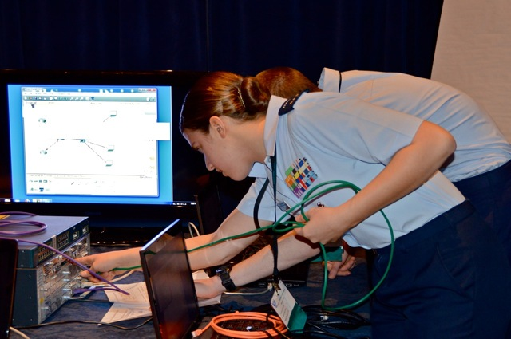
How you can help drive interest in STEM
Virtual or On-site Coaches/Mentors
Who: SE, CSE
What skills required: Desire to introduce kids to networking
How: Pick a school in you local-area and register to volunteer
Get Started: Attend Mentor Training session
Register: send email to: cyberpatriot-volunteers@cisco.com

Slide 7
CyberPatriot Volunteer Timeline
Coaches/Mentors:
Visit local schools
Host technical sessions to review CP6 topics
National Competition:
CP6 in Washington DC
Packet Tracer training:
* Sept. 26
* October 4
On-site coaching focus
Coaches:
* Last onsite visit
Mentor Training
* WebEx
* Show and share
Virtual coaching focus
Sept
‘13
Oct
‘13
Nov
‘13
Dec
‘13
Jan
‘134
Feb
‘14
March
‘’14
April
‘14
Regional Competition
* Prep sessions
Volunteers meet with multiple teams over WebEx.
National finals prep
* 24 teams only

Slide 8
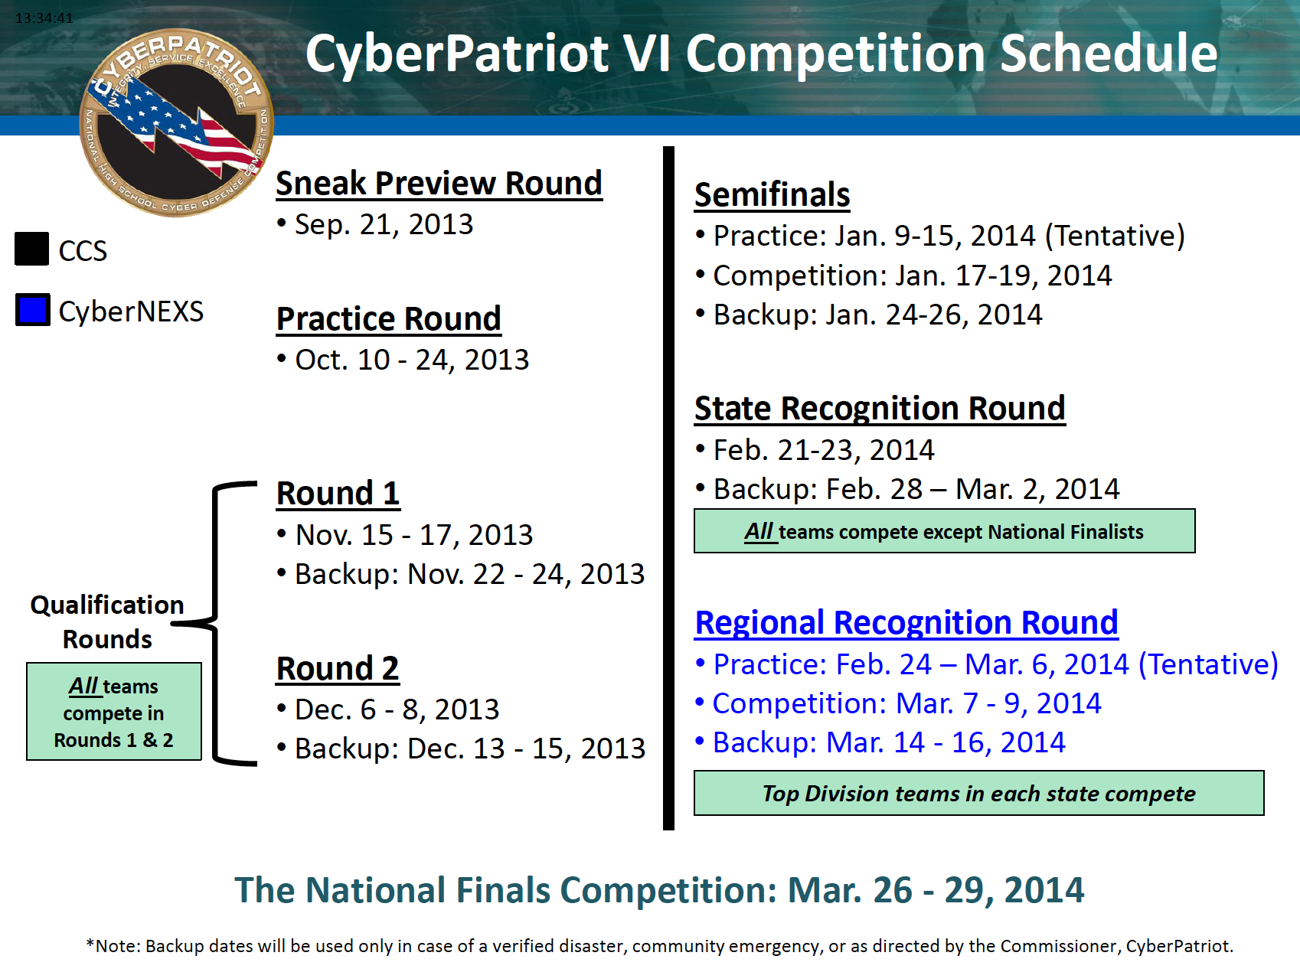
Tasks for NOS engineer first 6 months

Slide 9
CP6 Network Curriculum (1)
CyberPatriot VI –
Topic 1– Basics – Week of September 9th
Intro to networking (switch, router, etc)
OSI model
Packet Tracer
Topic 2– IOS fundamentals – Week of September 16th
Packet Tracer
Router/Switch Login basic command line
Intro to interfaces
VLANs
Topic 3– IP Addressing – Week of September 23rd
IP Addressing basics
L2/L3 interfaces
L3 IP Addressing

Slide 10
CP6 Network Curriculum (2)
CyberPatriot VI –
Topic 4 – Basic Routing – Week of September 30th
IP addressing a simple network
Static routing/RIP routing
L3 Tools (Ping, tracert)
Topic 5 – Access Lists –
Complex network setup with Static Routing
Standard Access Lists/Extended Access Lists
Concept of DMZ (perimeter network)
Topic 6 – Securing the network device –
Banners
Logging
Enable secret
Line/Con security
Access-List control of remote access
Topic 7 – DHCP/NAT -
DHCP
NAT
Topic 8– Bring it all together --
Full network scenario reviewing all topics.

Slide 11
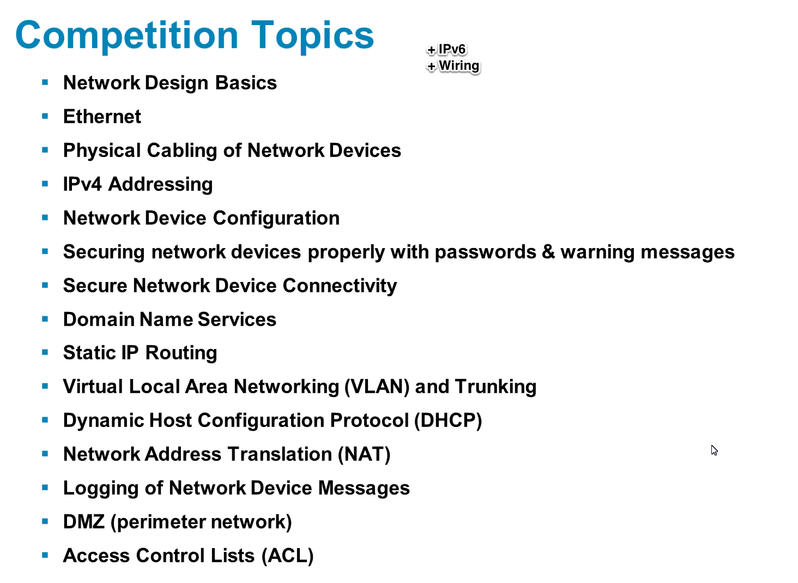
CP5 Cisco Topics

Slide 12
Cyber Patriot AM Volunteers
AM Volunteer activity
Attend Cyber Patriot Intro webinar
Visit a local High School and meet with the Cyber Patriot Team (Dec. 2-13)
Take/order Pizza
Discuss what you do and bring a guest speaker (PM, TME, Software Engineer, TAC Engineer, or Hardware Engineer)
We estimate 5 hours of time toward the US2020 Goal that Cisco has committed to for each AM (per school visited).
Notes:
Cyber Patriot
Group 1
1) attend Bootcamp training Nov 21
2) Visit schools December 9-20th
Group 2
1) Attend bootcampTraining Dec 17th
2) Visit schools January 7-17th
AM Ask

Slide 13
Cyber Patriot SE Volunteers
Group 1
Attend CP Bootcamp training Nov 21st
Host a Virtual Mentor session on 1 CP6 Topic (Dec 12-20th)
Optional: meet with a local CP6 team at local school Dec 2-13
Virtual Mentor Session (WebEx)
Create a 20-30 minute lecture on assigned topic
Create a Packet Tracer lab to augment the lecture and do a walk through
Post content on IWE page and distribute to CP Program
We estimate 20 hours of time toward the US2020 Goal that Cisco has committed to.
Notes:
Cyber Patriot
•SE Group 1
1)Attend CP Bootcamp training Nov 21st
2)Post a PacketTracer Lab Walkthrough (WebEx
recording)
3)Virtual Mentor sessions (2 session per SE): December 9-20th
SE Group 2
1) Attend Packet Tracer Training Dec 17th
2) Virtual Mentor sessions: January 7-17th
AM CP Optty
1) Attend CyberPatriot Intro session
2) Pick a school to visit
3) Find a guest speaker: TME/PM/HW Engineer, or Software Engineer
4) Take Pizza and host a WebEx with
=====================
Agenda:
1) Intro to CyberPatriot
2) Cyber Patriot Curriculum
Break for Email/phone calls (20 Minutes)
3) Packet Tracer intro
4) PacketTracer simple Exercise (hands-on)
Lunch (30 Minutes)
5) Break out sessions> build your lab
6) Review next steps and the logistics of mentoring

Slide 14
Volunteers for Topics
We will take a 15 minute break after getting volunteers for topics
(spreadsheet)

Slide 15
Break
15 Minutes
Back at: _______ EST
_______ CST
_______ PST

Slide 16
Packet Trace
What is Packet Tracer?
Where can I get it?
How can I share my labs with other coaches?
How do I share labs with Cyber Patriot teams?

Slide 17
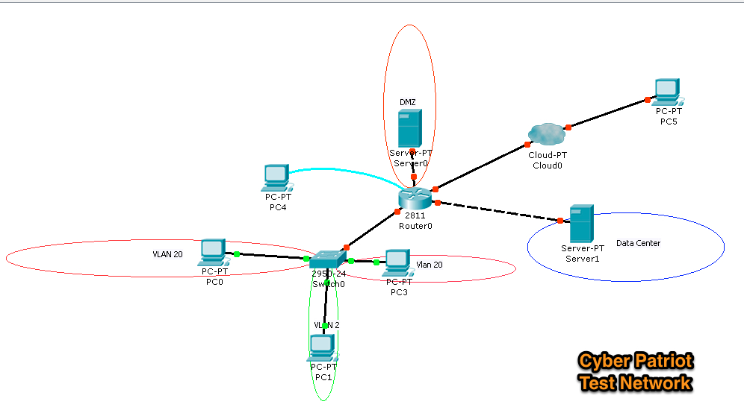
My Cyber Patriot network
Notes:
I built up toward this over a series of lectures and sessions.
I had 4 teams and the luxury of refining my content as I went forward.

Slide 18
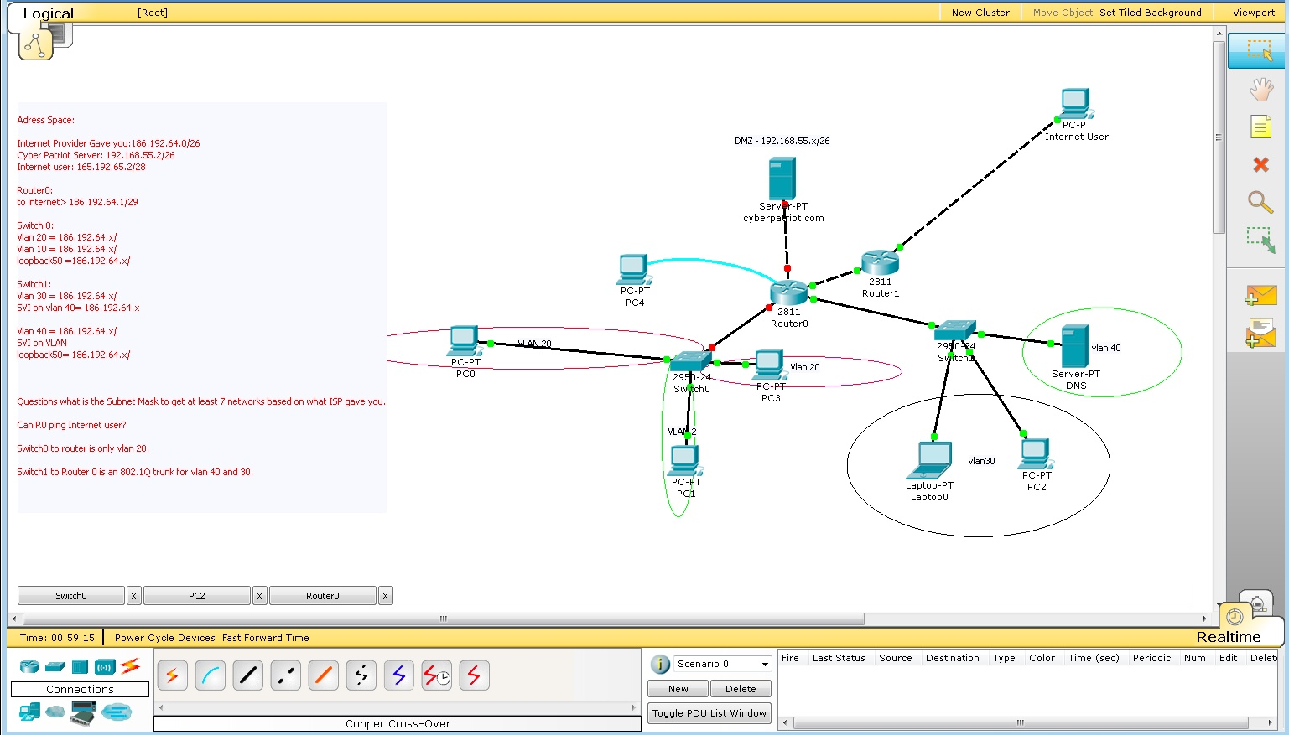

Slide 19
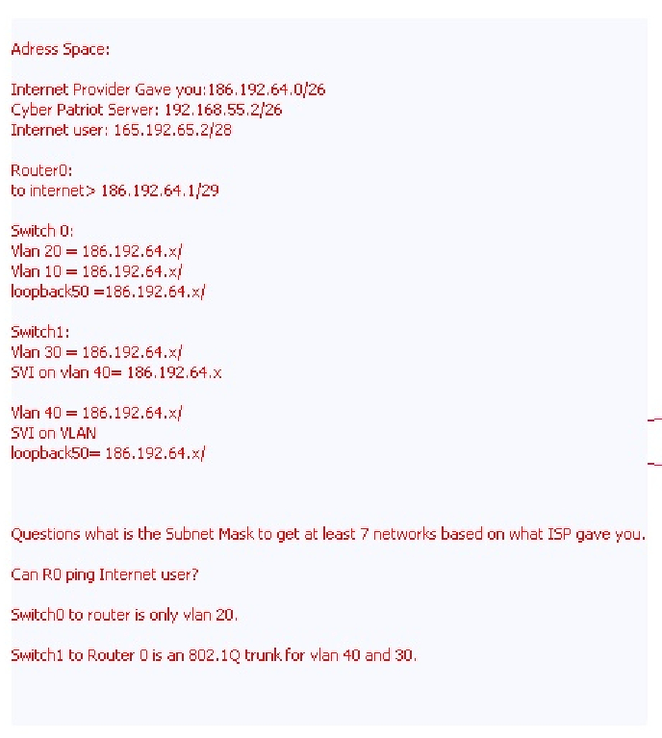
Notes:
http://www.youtube.com/playlist?list=PL680E4034BB33B41B

Slide 20
PacktTracer Tutorials/walkthroughs
http://www.youtube.com/playlist?list=PL680E4034BB33B41B
These videos are not half as good as having Karen Alderson show you around!

Slide 21
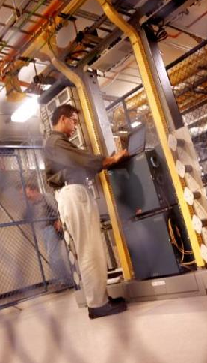
CP6 volunteer’s IWE Site
Our goal is to make it easy to volunteer. With sessions like this we want to “train the trainer.”
WebEx Social site for CyberPatriot Coaches:
http://iwe.cisco.com/web/cyberpatriot-field-portal

Slide 23
Cyber Patriot SoCal Named
Attend Packet Tracer Training (SE Team Event)
Two dates: November 21st or Dec 17th
One lesson Plan created with Packet Tracer Lab and accompanying instruction/solution
Post a 5-10 minute VoD walking through the Packet Tracer Lab exercise
In person visit December
Notes:
Cyber Patriot
Group 1
1) attend Packet tracer training Nov 21
2) Visit schools December 9-20th
Group 2
1) Attend Packet Tracer Training Dec 17th
2) Visit schools January 7-115th
AM Ask

Slide 24
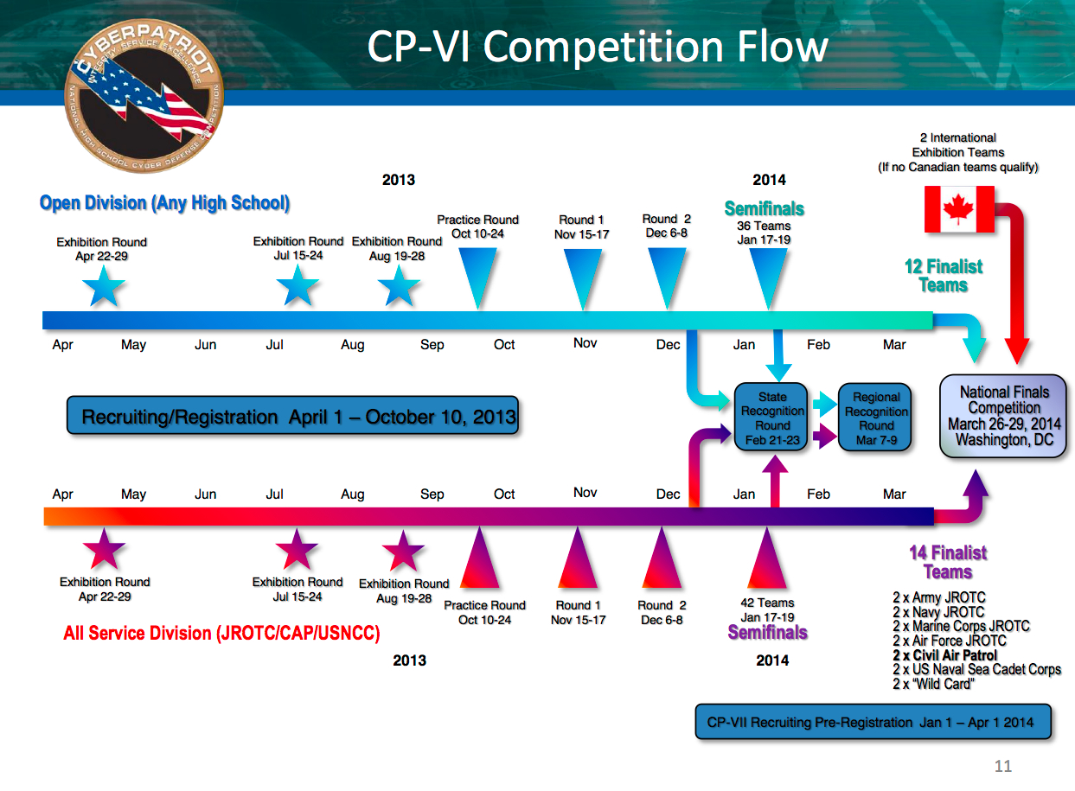

Slide 25
More info on the CP6
http://www.uscyberpatriot.org/CP5/CPVI%20Documents/Coaches_Meeting_10_11_Sep_2013.pdf
http://www.uscyberpatriot.org/CP5/CPVI%20Documents/CoachesMeetingAugust.pdf

